Slide 1

Hello Friends !! Welcome !!

Slide 2

Introduction
Certified Ethical Hacker
Malware Researcher
Bug Bounty Hunter
OSINT, SOCMINT,GEOINT Specialist
Cyber Crime Investigator

Slide 3
What is cyber security
Cyber security is the practice of protecting computer systems, networks, and data from digital attacks, unauthorized access, and data breaches. It involves implementing a combination of technologies, processes, in the digital space.

Slide 4
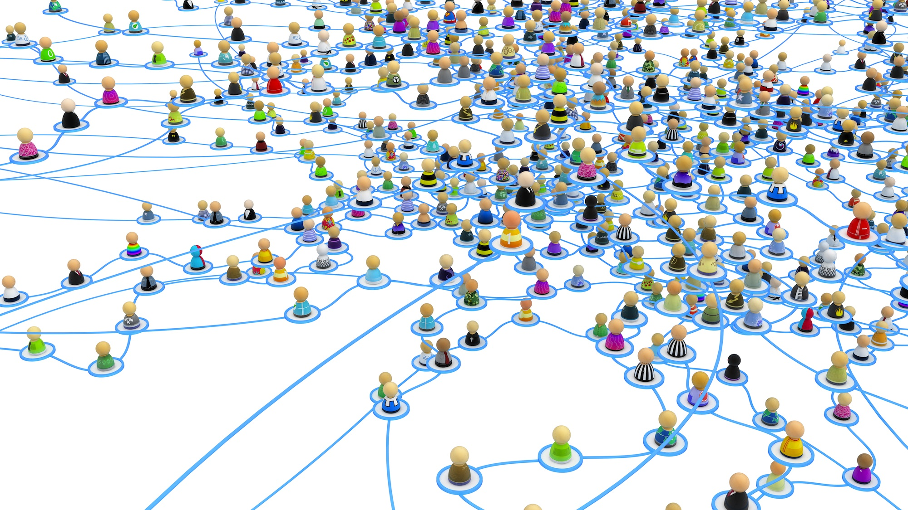
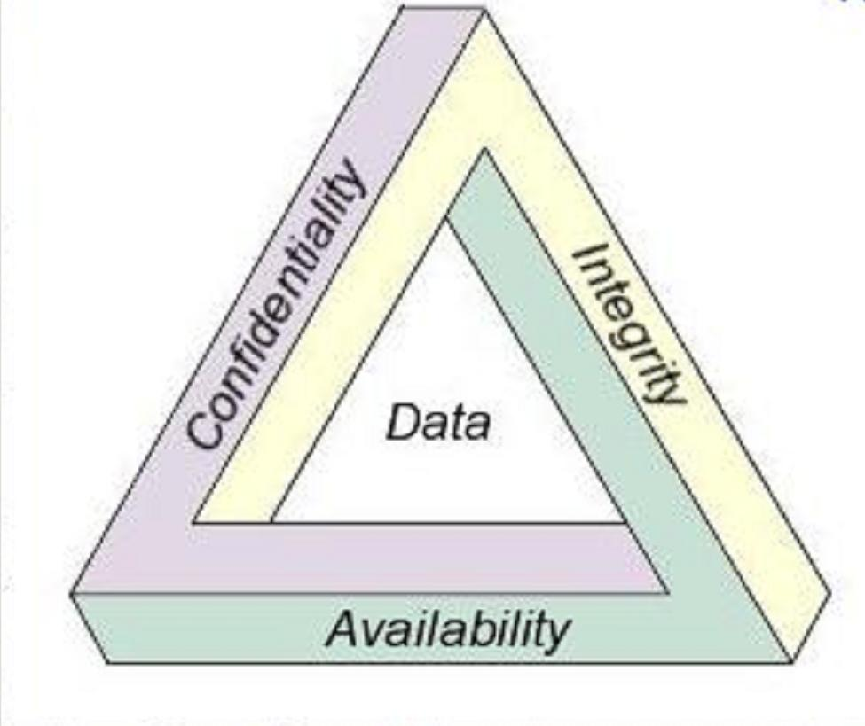
Key elements of cybersecurity
Confidentiality: Ensuring that sensitive information is accessible only to those who have the authorized permissions.
Integrity: Guaranteeing the accuracy and reliability of data and information by preventing unauthorized modifications.
Availability: Making sure that systems and data are accessible and operational when needed, preventing disruptions or downtime.

Slide 5
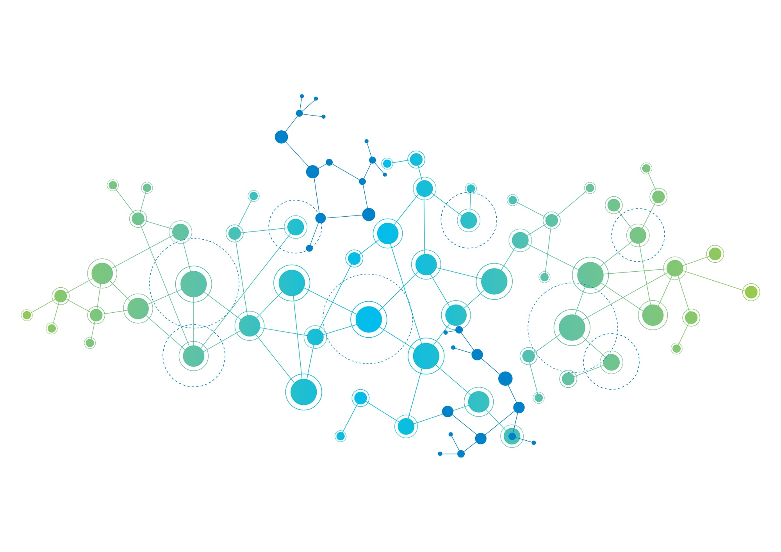
What is Network
A network is a collection of computers, servers, network devices, and other devices connected to one another for the purpose of sharing resources, information, and services

Slide 6
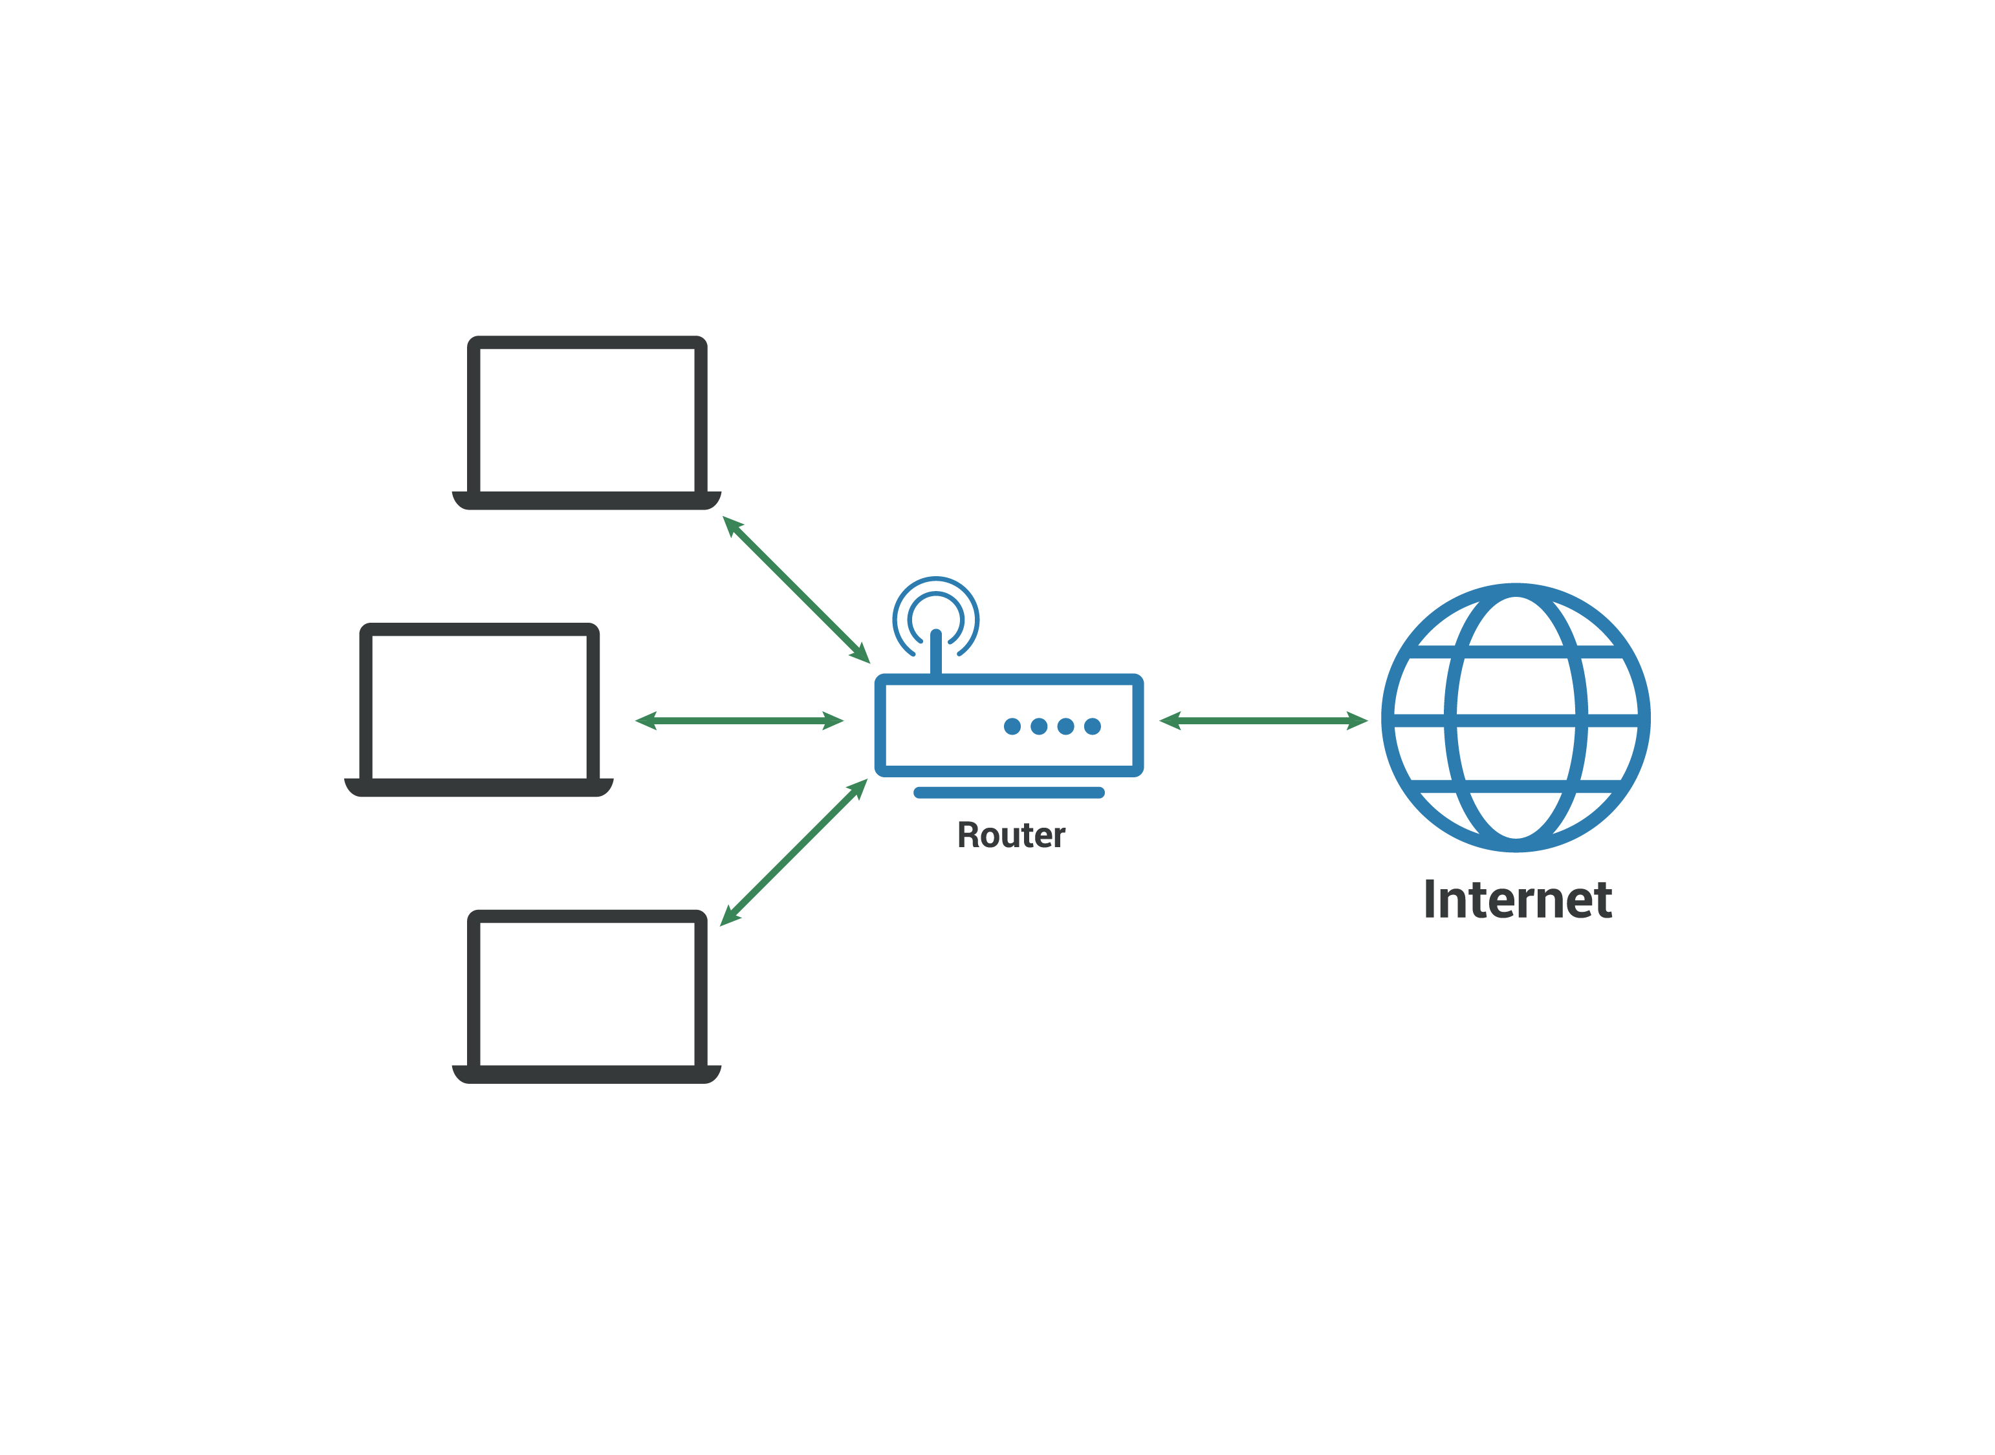
Types of Networks
LAN (Local Area Network): A two communicating device which are in room or on floor or in a single building or campus if are connected are said to be connected on LAN
WAN (Wide Area Network): A network that covers a broad area, often spanning multiple cities, countries, or continents.
MAN (Metropolitan Area Network): A network that covers a larger geographic area than a LAN but is smaller than a WAN, typically within a city

Slide 7
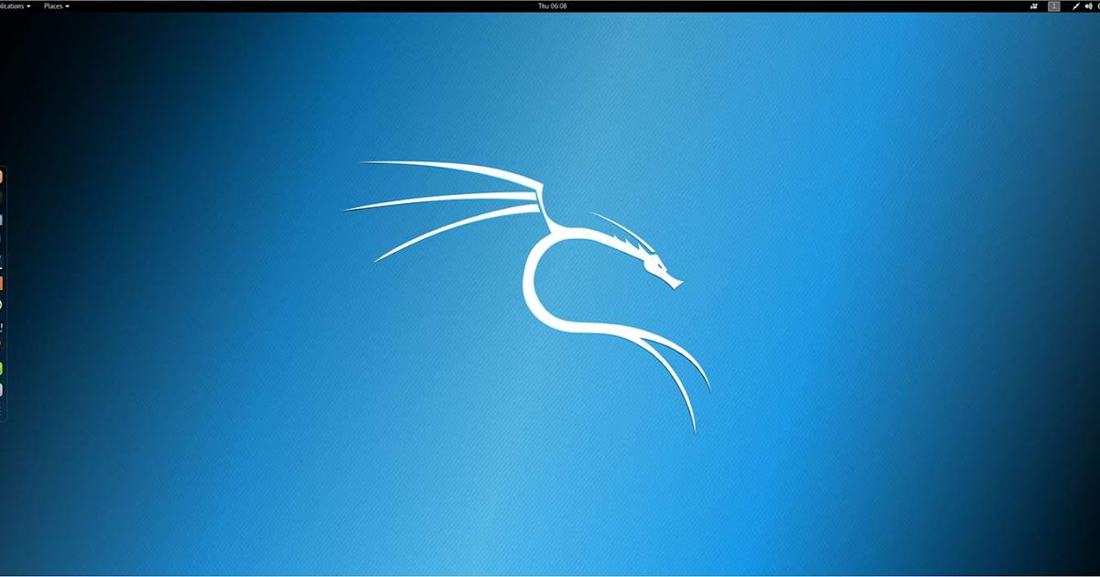
Why Hacker’s Use Linux
Hackers, especially ethical hackers and security professionals, use Kali Linux because it is a specialized and freely available operating system designed for penetration testing and ethical hacking. Kali Linux comes with a comprehensive suite of pre-installed security tools, is highly customizable, has an active community for support, receives regular updates, and is intended for legal and ethical use in identifying and addressing system vulnerabilities

Slide 8
What are cyber Attacks
Malware Attacks:
Viruses: Programs that replicate themselves by attaching to other executable files.
Worms: Self-replicating malware that spreads across networks without user intervention.
Trojans: Malicious software disguised as legitimate programs.
Phishing Attacks:
Deceptive attempts to trick individuals into revealing sensitive information, often through fake emails or websites.
Denial-of-Service (DoS) and Distributed Denial-of-Service (DDoS) Attacks:
Overloading a system, network, or service to make it unavailable to users.
4.Password Attacks:
Attempting to gain unauthorized access by exploiting weak passwords or using techniques like brute force or credential stuffing

Slide 9
What are APT Attacks
Advanced Persistent Threat, attacks are sophisticated and targeted cyber attacks carried out by well-funded and highly skilled threat actors. These attacks typically involve a prolonged and stealthy infiltration of a specific target with the aim of extracting sensitive information

Slide 10




